Slide 1
DSL Final Modification
Anuparna Ganguly
12-03-2026

Slide 2
Enhancements Made to the FlexNoC DSL Compiler
We can have any number of global variable declared and we will use this inside node attribute, e.x.
digraph G {
ingress1 = 3
egress1 = 4
ingress2 = 1
egress2 = 2
Q1 [type=QUEUE latency = ingress1 + egress2]
Q2 [type=QUEUE latency = ingress2 + egress2]
}
In the edges section we can declare delay using pipeline_delay attribute
IP6 ->Q1
Q1 -> ARB1
ARB1 -> SERVER1
SERVER -> Q2
Q2 --> ARB2 [ pipeline_delay = 10]
ARB 2-> SERVER2
SERVER2 -> Q4
Q4 -> DIE0 SERVER [pipeline_delay = 19]
DIE SERVER ->Sink

Slide 3
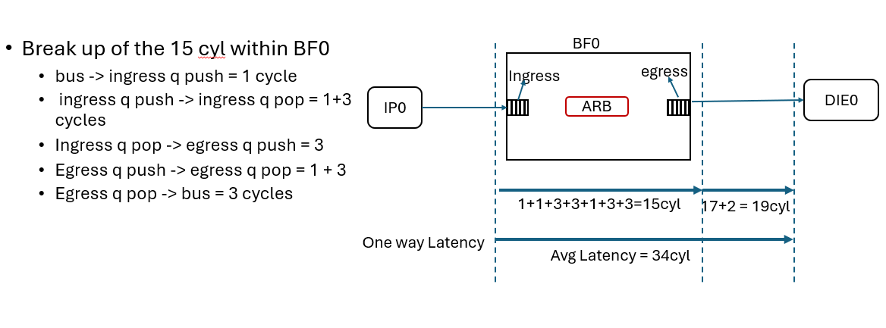
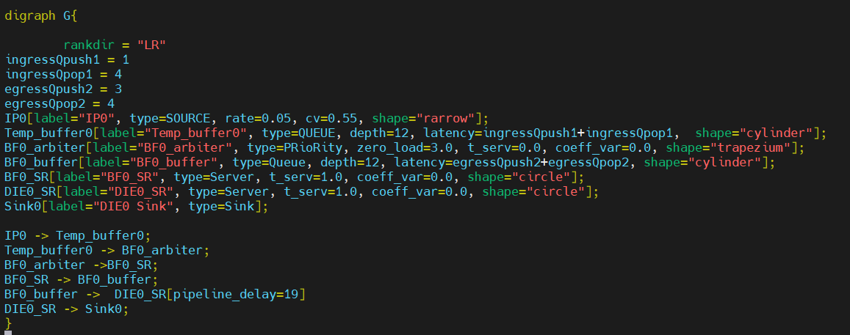
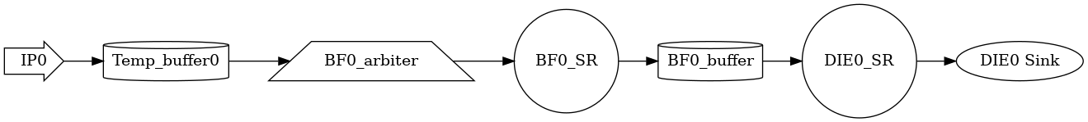
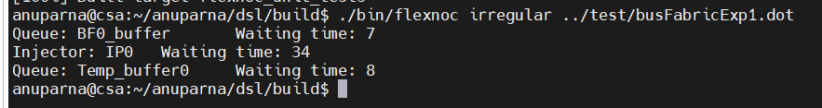
Experiment 1 : IP0->BF0->DIE0; NO IP6
Buffer size = 12
IP6 is inactive and doesn’t send any packets into the fabric.
ingressQpush1 = 1
ingressQpop1 = 4
egressQpush2 = 3
egressQpop2 = 4
Arbiter’s zero_load = 3
BF0 buffer -> DIE0 pipeline_delay = 19
../test/busFabricExp1.dot
o/p from FlexNoC
Autogenerated png file

Slide 4
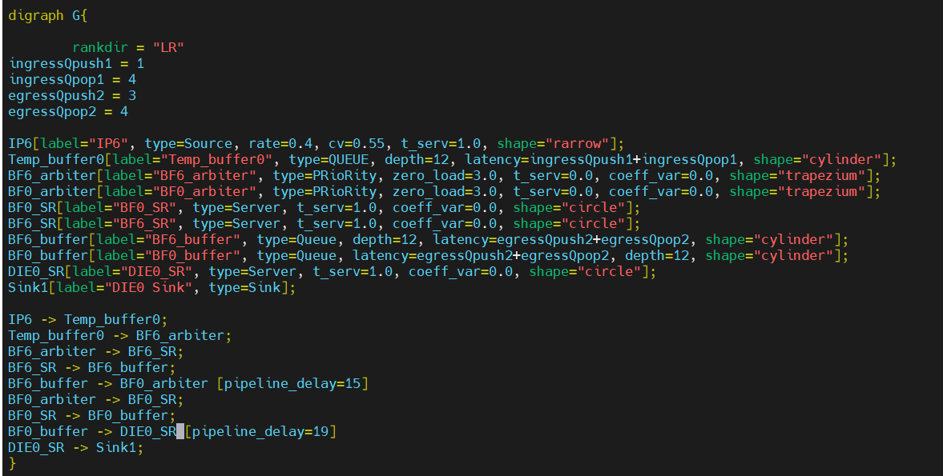
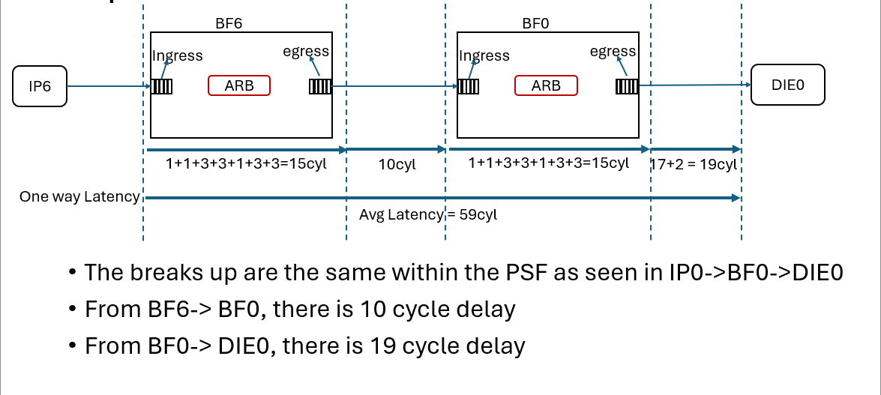
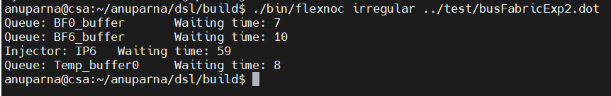
Experiment 2 : IP6->BF6->BF0->DIE0; NO IP0
ingressQpush1 = 1
ingressQpop1 = 4
egressQpush2 = 3
egressQpop2 = 4
Arbiter’s zero_load = 3
BF6 buffer -> BF0 arbiter pipeline_delay = 15
BF0 buffer -> DIE0 pipeline_delay = 19
../test/busFabricExp2.dot
o/p from FlexNoC
Autogenerated png file

Slide 5
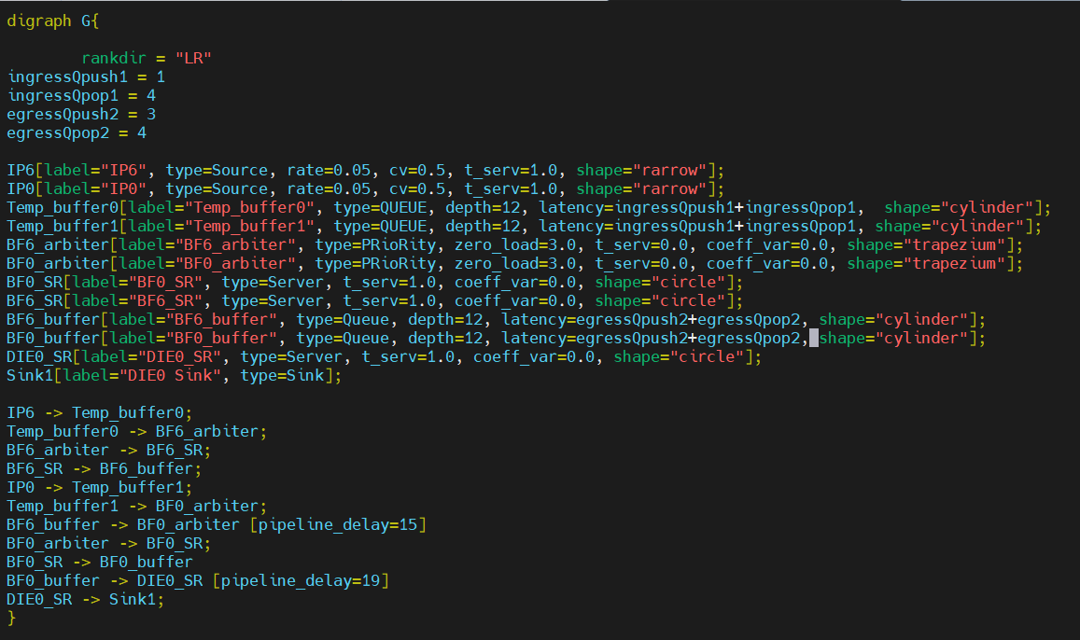
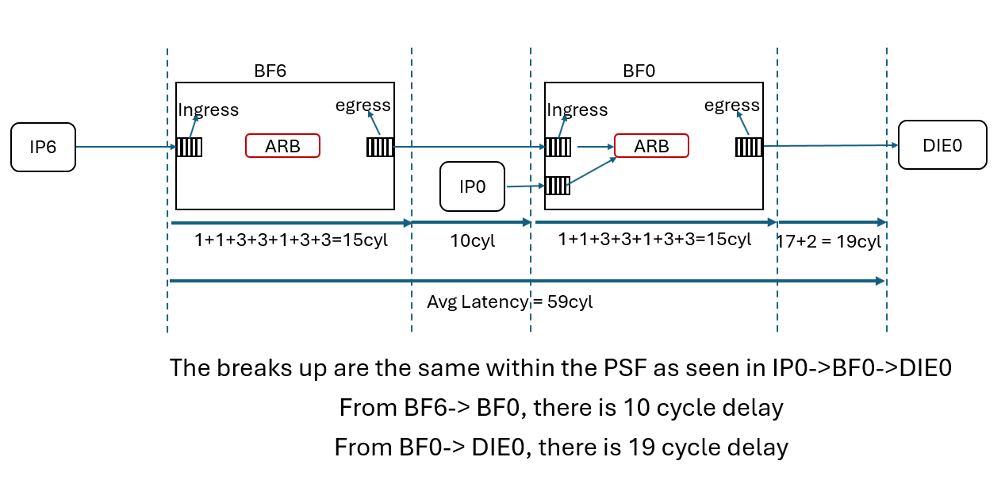
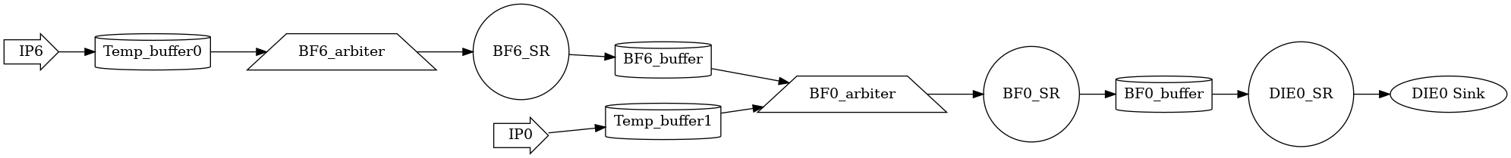
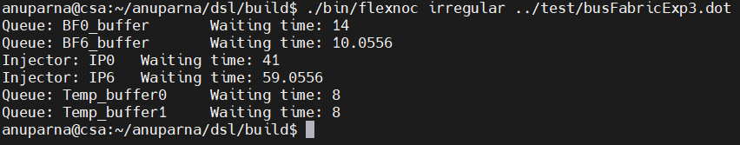
Experiment 3: Both IP6 & IP0 has lower injection
ingressQpush1 = 1
ingressQpop1 = 4
egressQpush2 = 3
egressQpop2 = 4
Arbiter’s zero_load = 3
BF6 buffer -> BF0 arbiter pipeline_delay = 15
BF0 buffer -> DIE0 pipeline_delay = 19
../test/busFabricExp3.dot
o/p from FlexNoC
Autogenerated png file

